Slide 1

Rules Changes
Season 2026-27

Slide 2


Rules Changes for Season 2026-27
Rule 9.2.2 –
The ball must not be caught and/or thrown
It can rebound in any direction
Very brief contact with the ball is allowed
To push/lift/carry the ball is not permitted

Slide 3
Rules Changes for Season 2026-27
The tip must be:
Executed with fingers of one hand
Executed with a brief contact
Directed in a straight line.

Slide 4
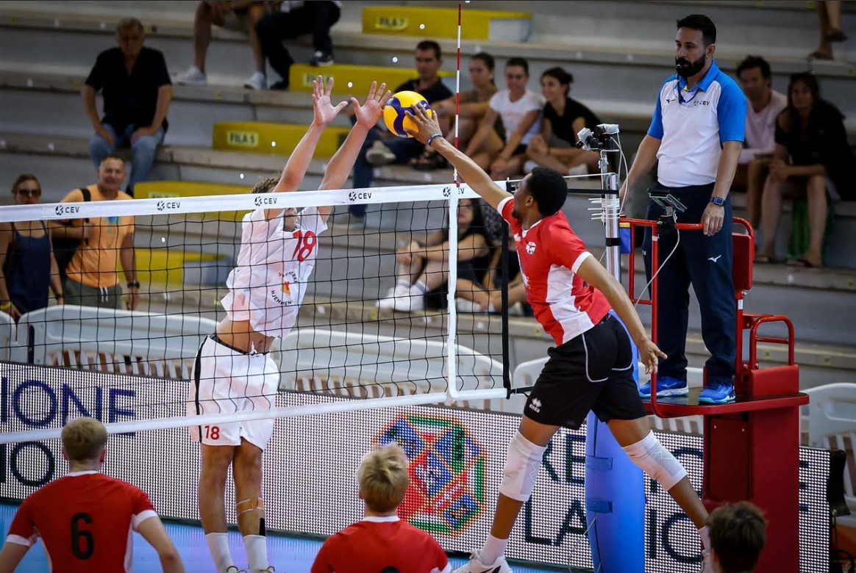

Slide 5
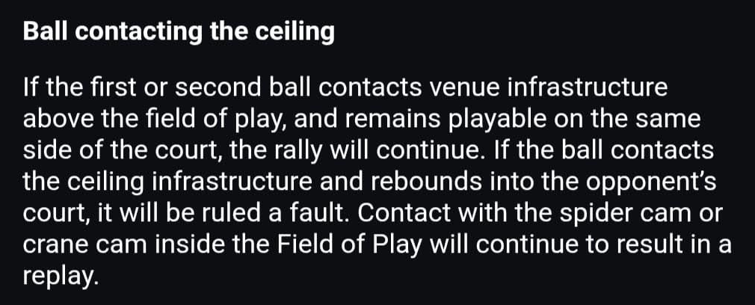
Rules Changes for Season 2026-27

Slide 6
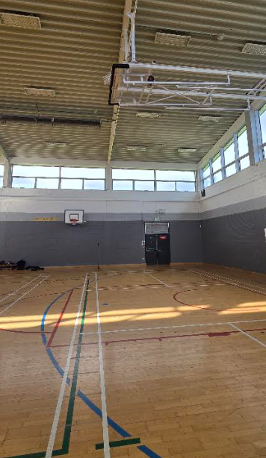
Rules Changes for Season 2026-27

Slide 7
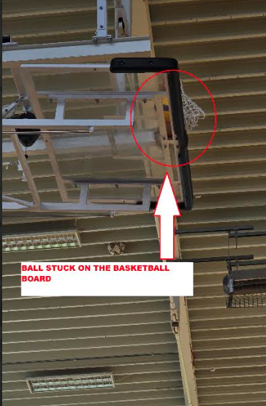
Rules Changes for Season 2026-27

Slide 8
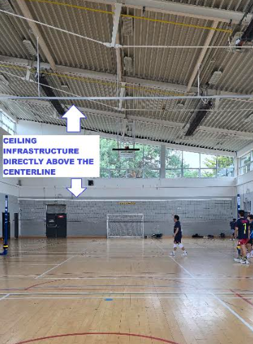
Rules Changes for Season 2026-27

Slide 9
Rules Changes for Season 2026-27
Ball contacting the ceiling – If after the first or second team hit, the ball hits the venue infrastructure above the field of play and:
Remains above own court – No fault and the rally continues;
Rebounds to the opposing court – Fault.

Slide 10
Rules Changes for Season 2026-27
The control of the receiving team’s position – The receiving team’s players must be in the correct position from the referee whistle for service until the moment of the server’s motion begins for the service (a step, arm movement, legs in the first motion to serve).
The players must stay inside the court’s boundaries until the service hit.

Slide 11
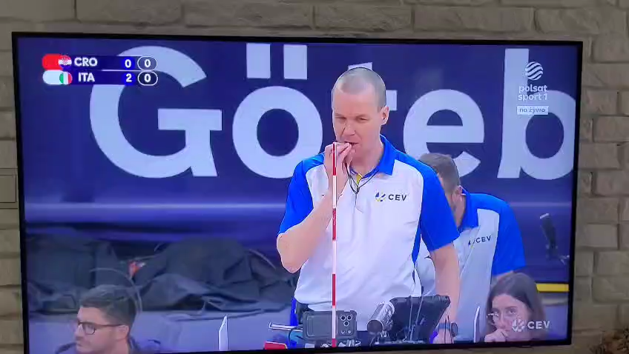
Rules Changes for Season 2026-27

Slide 12
Rules Changes for Season 2026-27
Number of substitutions – The permitted number of substitutions is increased from 6 to 8.
The 2nd referee will inform coaches or captain about the 7th and 8th substitution.
All other substitution rules remain unchanged.

Slide 13
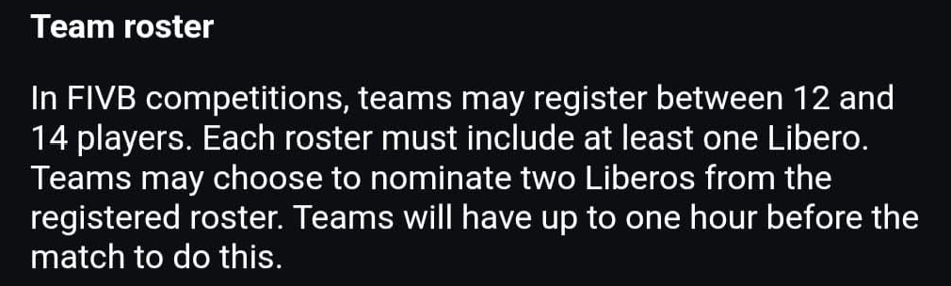
Rules Changes for Season 2026-27

Slide 14
Rules Changes for Season 2026-27
Team Roster – In the FIVB World and Official Competitions and VLY National League and Association Cup, the maximum number of registered players in the scoresheet is 14.
  6 players – no libero
  7 to 12 players – zero, one or two liberos
  13 and/or 14 players – one or two liberos

Slide 15
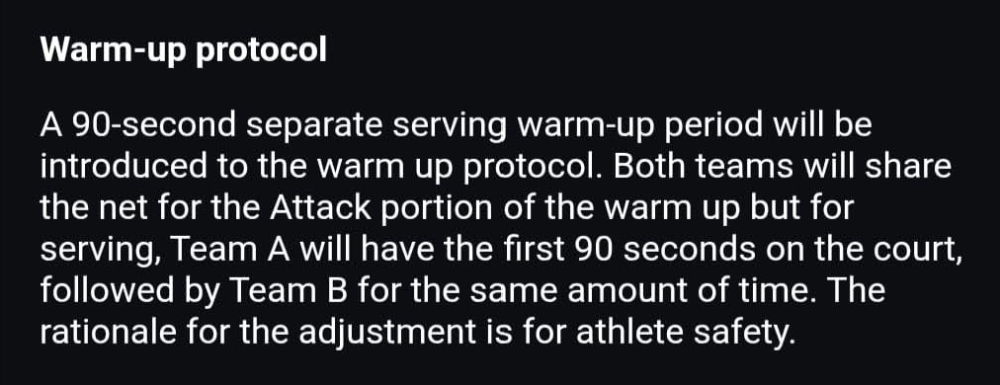
Rules Changes for Season 2026-27

Slide 16
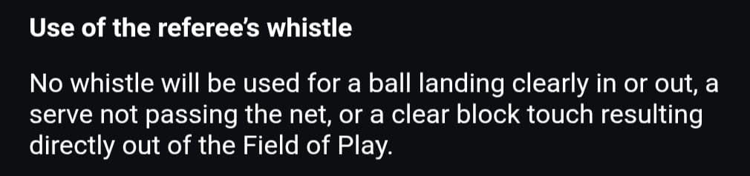
Rules Changes for Season 2026-27

Slide 17


